Slide 1
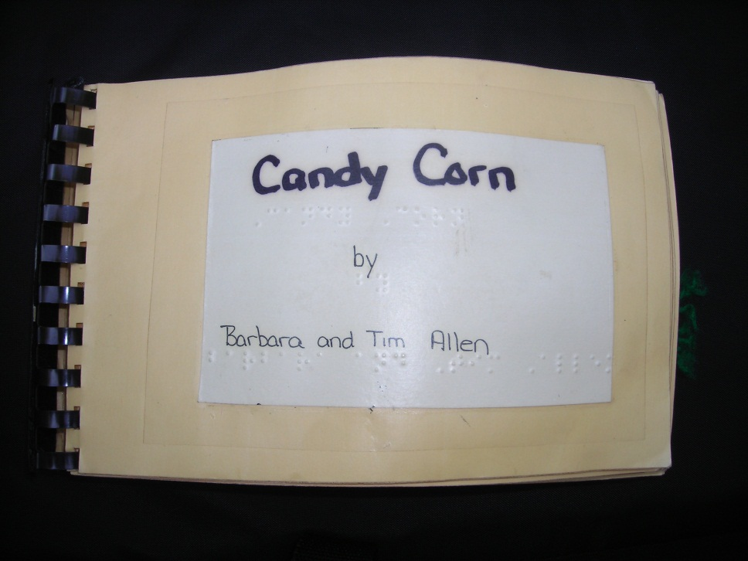
Candy Corn
By Barbara and Tim Allen

Slide 2
Once there was a pumpkin named Jack. One October night Jack went for a walk.

Slide 3
As he walked, Jack found one piece of candy corn. He picked it up and walked along.

Slide 4
Soon he met a ghost who was crying. “I lost my piece of candy corn,” cried the ghost.

Slide 5
“Here,” said Jack. “This must be yours.” He gave the candy to the ghost and continued walking.

Slide 6
As he walked, Jack found two pieces of candy corn. He picked them up and walked along.

Slide 7
Soon he met a bat who was crying. “I lost two pieces of candy corn,” cried the bat.

Slide 8
“Here,” said Jack. “These must be yours.” He gave the candy to the bat and continued walking.

Slide 9
As he walked, Jack found three pieces of candy corn. He picked them up and walked along.

Slide 10
Soon he met a witch who was crying. “I lost three pieces of candy corn,” cried the witch.

Slide 11
“Here,” said Jack. “These must be yours.” He gave the candy to the witch and continued walking.

Slide 12
As he walked, Jack found four pieces of candy corn. He picked them up and walked along.

Slide 13
Soon he met a mummy who was crying. “I lost four pieces of candy corn,” cried the mummy.

Slide 14
“Here,” said Jack. “These must be yours.” He gave the candy to the mummy and continued walking.

Slide 15
As he walked, Jack found five pieces of candy corn. He picked them up and walked along.

Slide 16
Soon he met a spider who was crying. “I lost five pieces of candy corn,” cried the spider.

Slide 17
“Here,” said Jack. “These must be yours.” He gave the candy to the spider and continued walking.

Slide 18
Jack started walking home. He was glad that he had helped his new friends, but was a little sad because he had no candy.

Slide 19
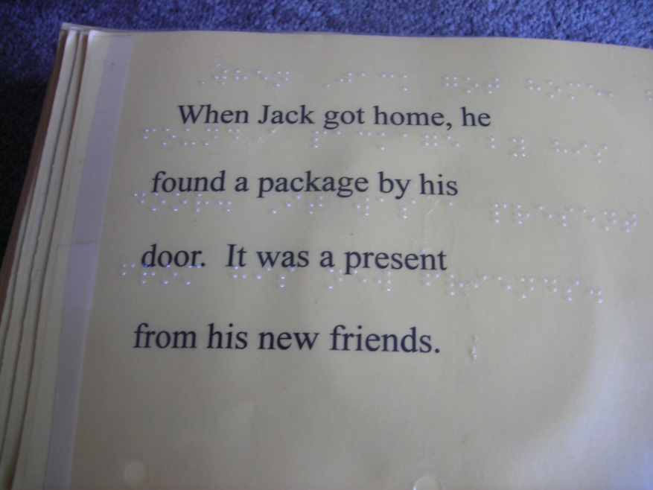

Slide 20
Inside were five pieces of candy corn.

