Slide 1
Relating Braille reading difficulties to developmental dyslexia: first empirical evidence Anneli Veispak, Bart Boets & Pol Ghesquière
Research Summit on Braille Reading and Writing
June 10-12, 2010,
in Denver, Colorado

Slide 2
Outline
Theoretical framework
-From Dyslexia to Braille reading
Experimental setup
- Participants
- Experiments
Expected results & results

Slide 3
Theoretical framework
Reading
Print Reading
Braille Reading
Developmental Dyslexia
Fluent print
reading
Problematic Braille reading
Fluent Braille reading
Poor Ability to read Good
?
?
Prerequisites for reading

Slide 4
Developmental Dyslexia
Visual processing
Temporal auditory processing
Tactual processing
Speech perception
Orthographic ability
Phonological processing
phonological awareness PA,
verbal short term memory VSTM,
rapid automatic naming RAN
Serious reading and spelling difficulties

Slide 5
Theoretical framework
Print reading |  | Dyslexia | Problematic Braille reading | Braille reading
Visual processing | Auditory processing | Temporal auditory, visual and tactual processing affected | ? | Auditory processing ? | Tactual Processing ?
Ortho-graphic ability | Speech perception | Subtle speech perception problems | ? | Speech perception ? | Ortho-graphic ability ?
 | Phonological processing: PA VSTM RAN | Phonological processing affected | Phonological processing affected | Phonological processing: PA
Fluent reading and spelling |  | Reading and spelling affected |  | Fluent reading and spelling

Slide 6
Theoretical framework
The aim of the current study is to find out whether the correlational and causal pattern between temporal processing, speech perception, phonological processing and reading is the same both in print- and Braille reading population.
Where do the differences lie?
Additionally…whether tactual sensitivity correlates with Braille reading performance (reading speed and accuracy)?

Slide 7
Experimental setup
Participants:
Normal intelligence
No deficiencies in audiology
Speak Dutch and Estonian as their first language respectively
 | Braille readers | Print Readers
Belgium | n= 12 | n= 10
Estonia | n= 15 | n= 14

Slide 8
Experimental setup
Experiments:
Reading tests
- Word reading,
- Pseudo-word reading,
- Story reading

Slide 9
Experimental setup
Phonological processing tests
-Phonological awareness (phoneme deletion, spoonerism)
- Verbal short-term memory (digit span, pseudo-word repetition)
- Rapid Automatic naming (letters, numbers)

Slide 10
Experimental setup
Speech perception tests
- Words in noise
- Sentences in noise
- Categorical perception (bA- dA)

Slide 11
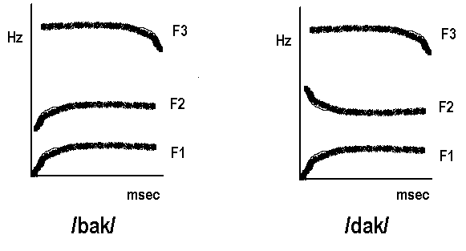
Speech perception
Sound = vibrations with a specific frequency and amplitude
Speech perception requires adequate tracking of rapid transitions in frequency and amplitude
Spectogram

Slide 12
Speech perception tests
SPEECH-IN-NOISE PERCEPTION
Noise = 70 dB SPL
Presentation of 3 x 22 one-syllable words
Three SNR-levels
-3 dB SNR -2 dB SNR
-6 dB SNR -5 dB SNR Estonia
-9 dB SNR -8 dB SNR
CATEGORICAL PERCEPTION
→ 10 step continuum /ba/ - /da/
Belgium

Slide 13
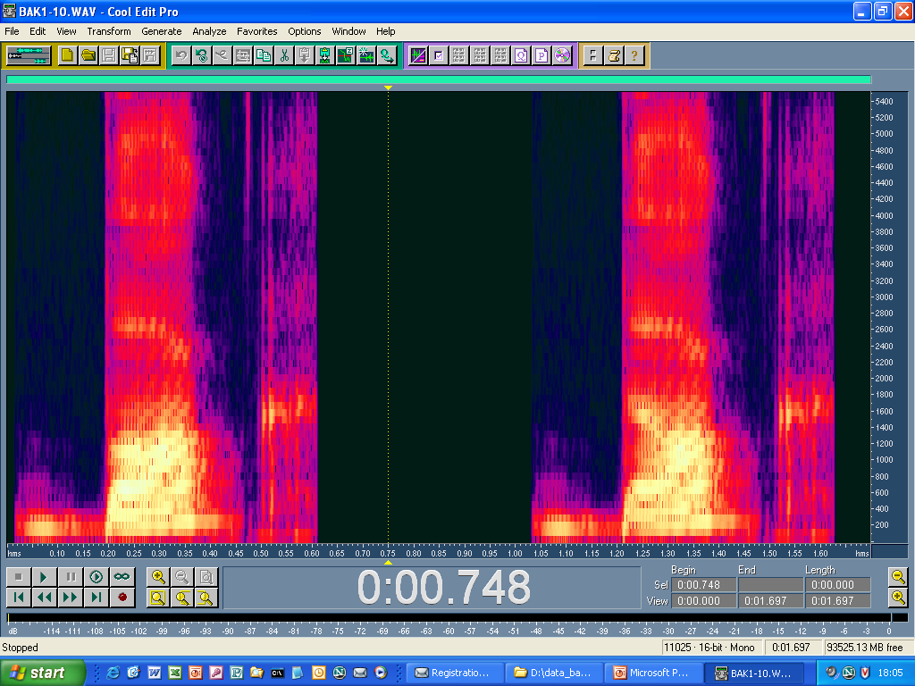
/ba/
/da/
10 physically equal steps

Slide 14
Experimental setup
Auditory tests
- Gap-in-noise detection test (GAP)
- 2 Hz Frequency modulation detection (FM)
- Tone-in-noise detection test (TN)

Slide 15
Gap-in-noise detection test
target = white noise containing a silent gap
reference = uninterrupted white noise
variable = length of gap
ISI
gap(ms)
target
reference

Slide 16
2 Hz Frequency modulation detection
target = 2Hz FM of a 1 kHz carrier tone
reference = 1 kHz pure tone
variable = modulation depth
modulation depth (Hz)
ISI
target
reference

Slide 17
Tone-in-noise detection test
target = 1 octave band noise (55 dB) at 1kHz with 2 sinusoid pulses of 1kHz
reference = 1 octave band noise (55 dB) at 1kHz
variable = amplitude of pulses
Amplitude (dB)
ISI
target
reference

Slide 18
Experimental setup
Tactual sensitivity test
- Grating orientation task
Johnston-Van Boven-Phillips Domes. A set of eight different plastic gratings used for assessing tactile spatial resolution. Dome ratings have equidistant bar and groove widths measuring 0.35, 0.50, 0.75, 1.00, 1.25, 1.50, 2.00, and 3.00 mm.

Slide 19
Analysis and Results
Data analysis in progress

Slide 20
Main references
Arter, C.A. (1998). Braille dyslexia: Does it exist? British Journal of Visual Impairment, 16(2), 61-64.
Boets, B., De Smedt, B., Cleuren, L., Vandewalle E., Wouters, J., & Ghesquière, P. (2010). Towards a further characterization of phonological and literacy problems in Dutch-speaking children with dyslexia. British Journal of Developmental Psychology, 28, 5-31.
Coppins, N., & Barlow-Brown, F. (2006). Reading difficulties in blind, Braille-reading children. British Journal of Visual Impairment, 24(1), 37-39.
Dodd, B., & Conn, L. (2000). The Effect of Braille Orthography on Blind Children‟s Phonological Awareness. Journal of Research in Reading, 23, 1–11.
Gillon, G.T. & Young, A.A. (2002). The phonological awareness skills of children who are blind. Journal of Visual Impairment and Blindness, 96, 38–49.
Grant, A.C., Zangaladze, A., Thiagarajah, M.C., & Sathian, K. (1999). Tactile perception in developmental dyslexia: a psychophysical study using gratings. Neuropsychologia 37, 1201-1211.
Millar, S. (1997). Reading by Touch. New York: Routledge .
Phillips, J.R., Johansson, R.S. & Johnson, K.O. (1990). Representation of braille characters in human nerve fibres. Experimental Brain Research, 81, 589-592.
Stein, J. (2000). The neurobiology of reading difficulties. Prostaglandins, Leukotrienes and essential fatty acids, 63(1/2), 109-116.
Stein, J. (2001). The magnocellular theory of developmental dyslexia. Dyslexia, 7, 12-36.
Stoodely, C.J., Talcott, J.B., Carter, E.L., Witton, C., & Stein, J.F. (2000). Selective deficits of vibrotactile sensitivity in dyslexic readers. Neuroscience letters, 295, 13-16.

