Slide 1
Top Access Tips – Pictures and Illustrations

Slide 2
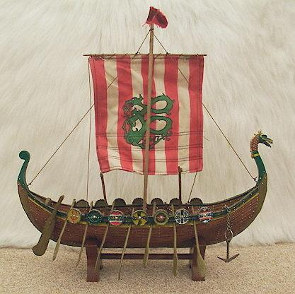
Positioning of text against image
Viking boats
Place the image on the opposite page to the text.
Place captions in same location on each image.
Viking boat

Slide 3
Clear, well contrasting image

Slide 4
Clear photograph

Slide 5
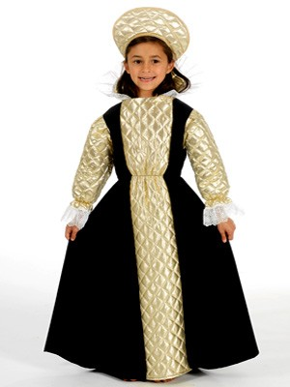
Clear well contrasting photograph

Slide 6
Simple clear photographs

Slide 7
Simple clear photographs

