Slide 1
Let’s Make Macaroni and Cheese
This power point book was made by Holly Cooper, Ph.D.; Texas School for the Blind and Visually Impaired Outreach

Slide 2
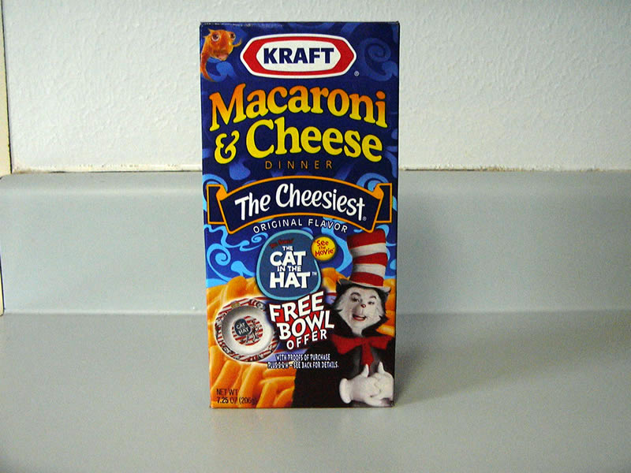
Macaroni and cheese is my favorite thing to eat.

Slide 3
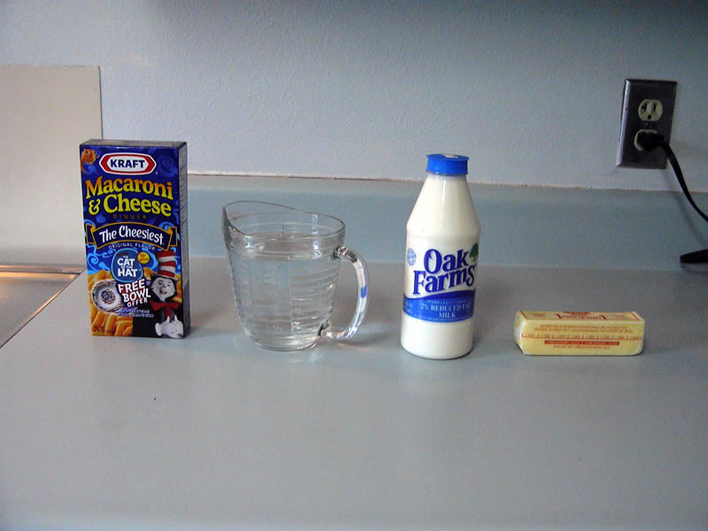
First, get all your ingredients.

Slide 4
Get your macaroni and cheese mix.

Slide 5
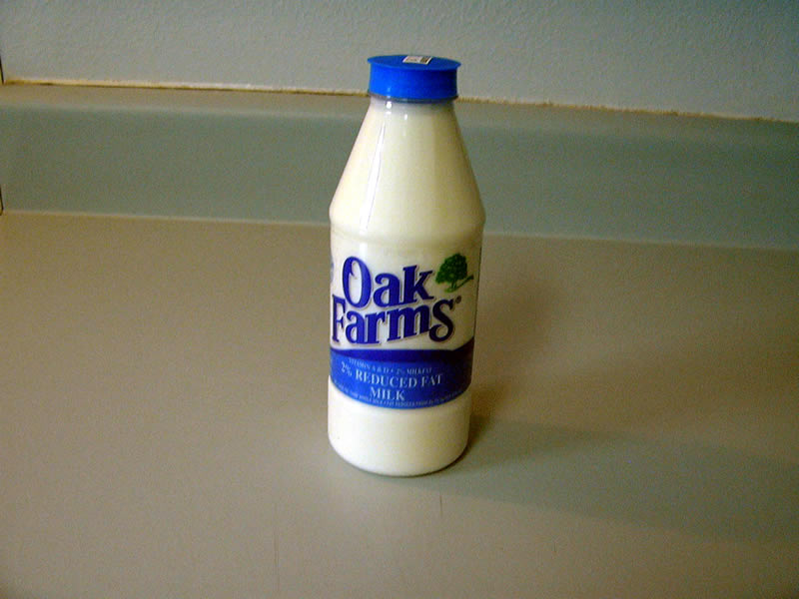
You will need some milk.

Slide 6
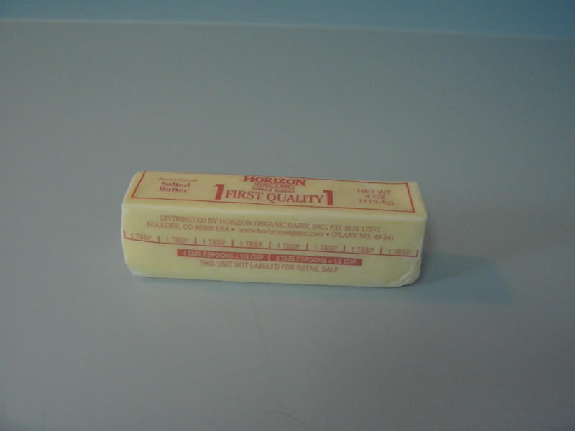
You will need some butter.

Slide 7
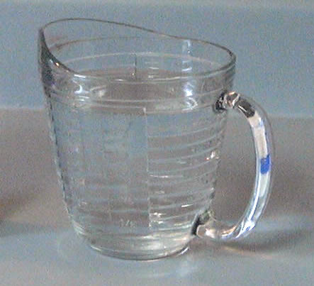
You will also need water.

Slide 8
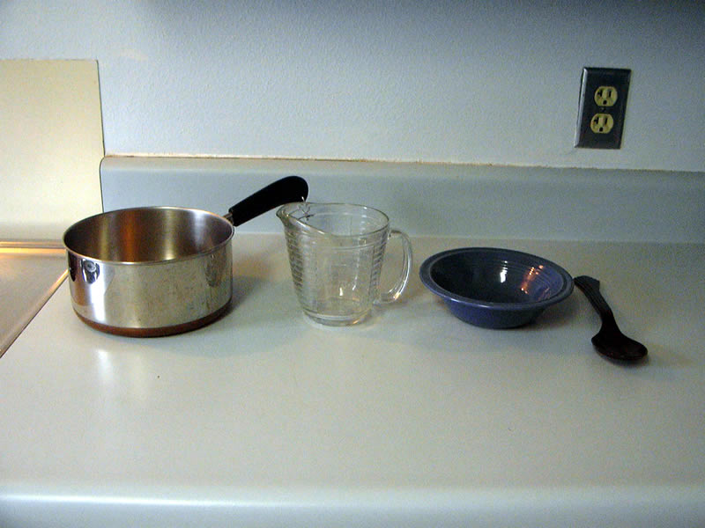
Then get all your utensils.

Slide 9
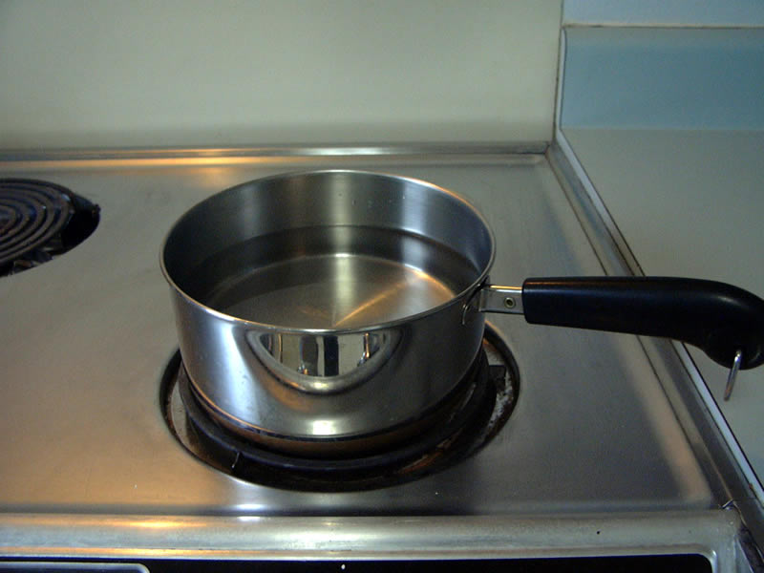
Fill the pan with water and put it on the stove.

Slide 10
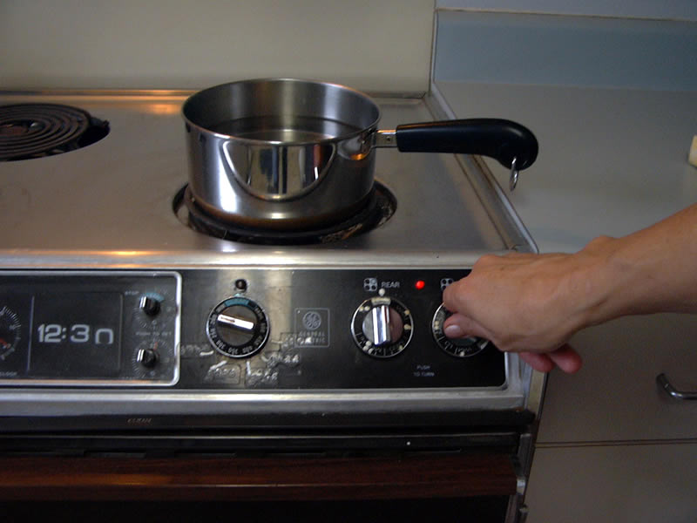
Turn on the stove.

Slide 11
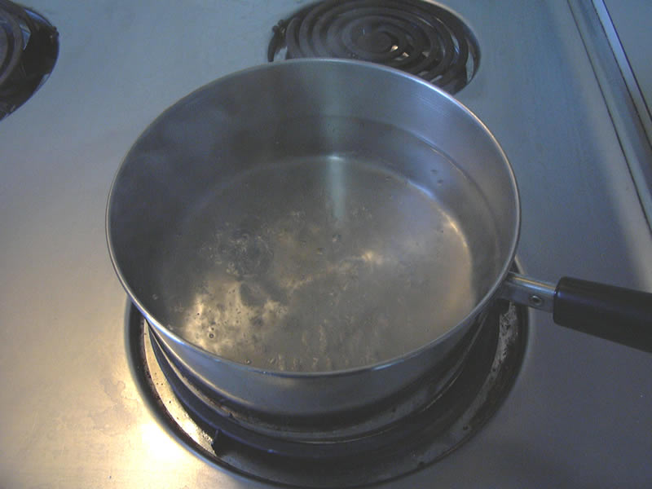
Wait for the water to boil.

Slide 12
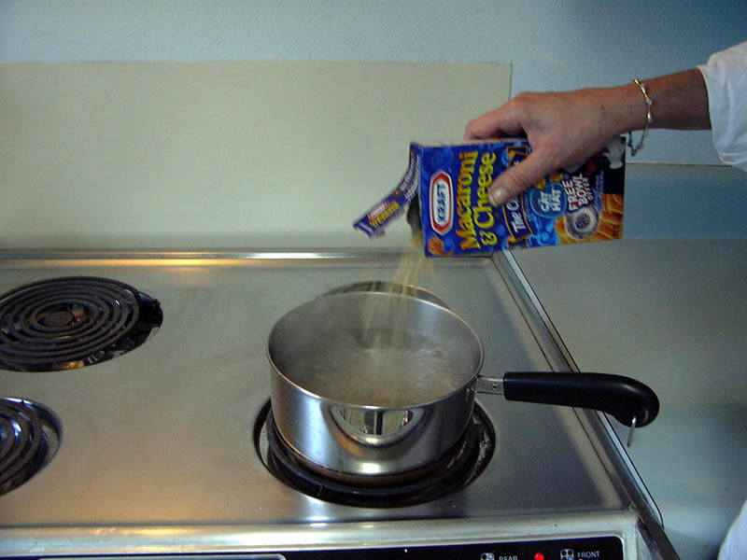
Pour in the macaroni.

Slide 13
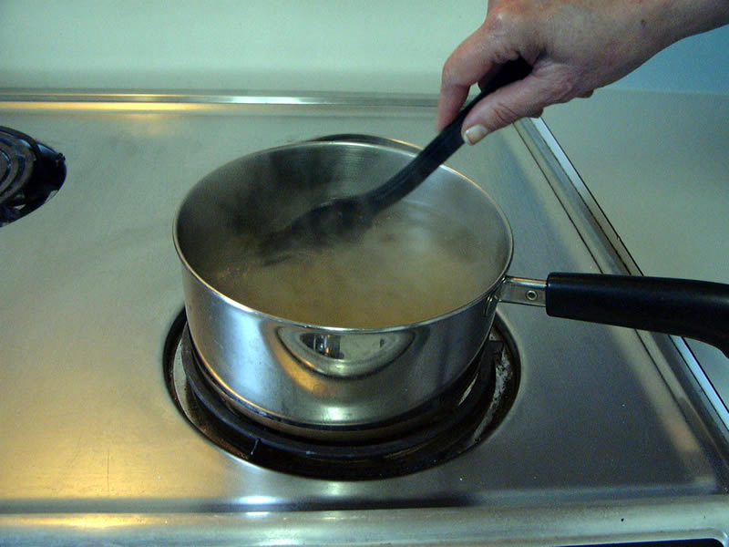
Boil the macaroni for 8 to 10 minutes.

Slide 14
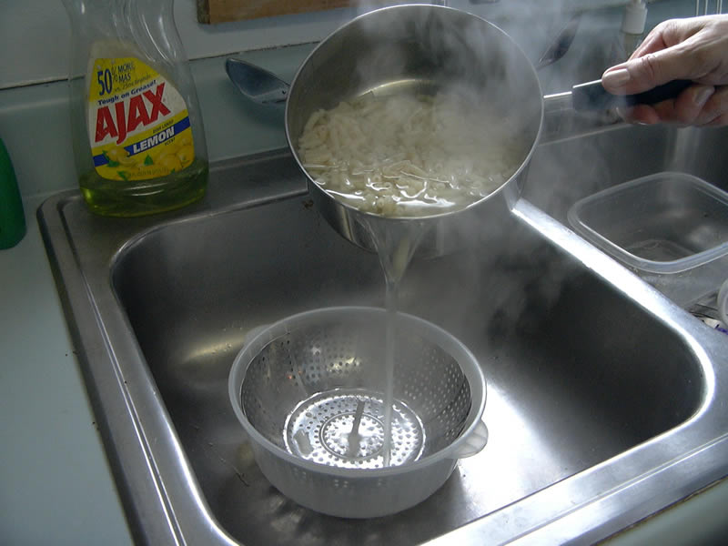
When the macaroni is done, pour out the water.

Slide 15
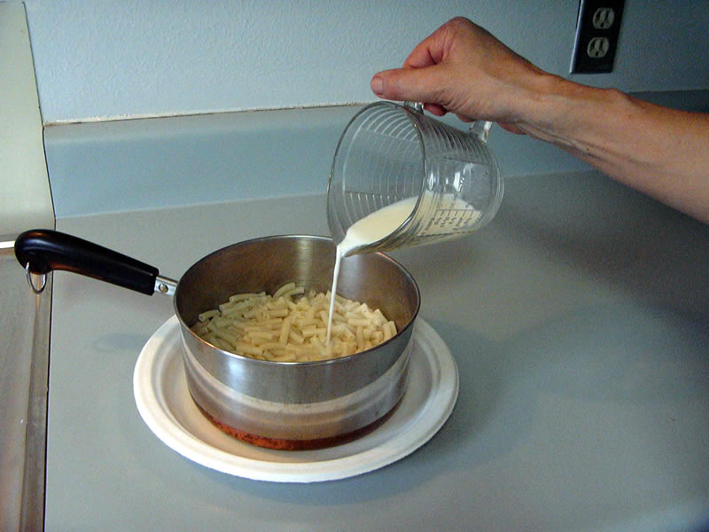
Then, pour milk on the macaroni.

Slide 16
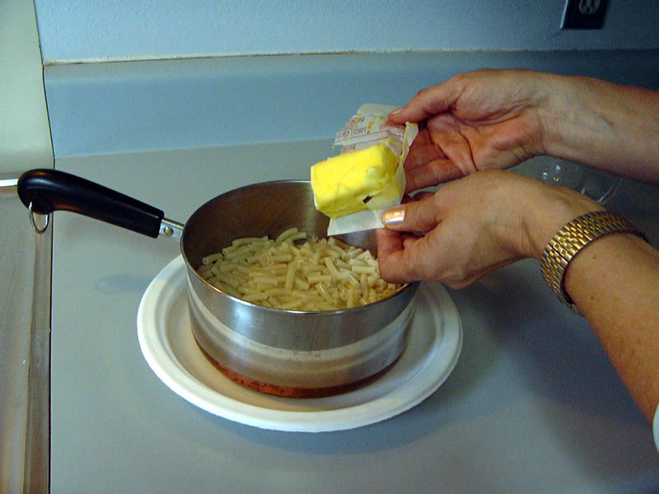
Add the butter.

Slide 17
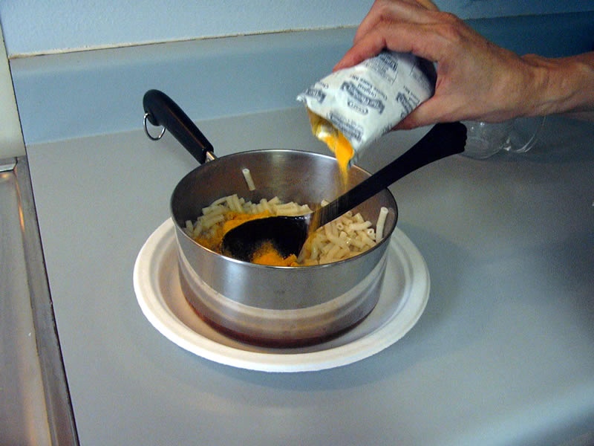
Sprinkle in the cheese.

Slide 18
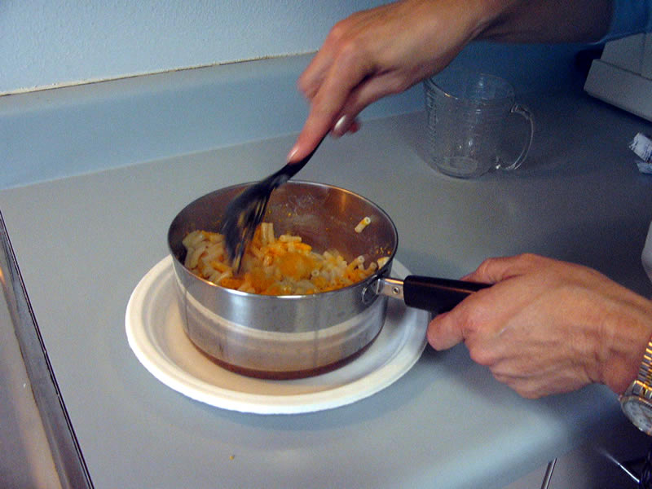
Stir it until everything is mixed together.

Slide 19
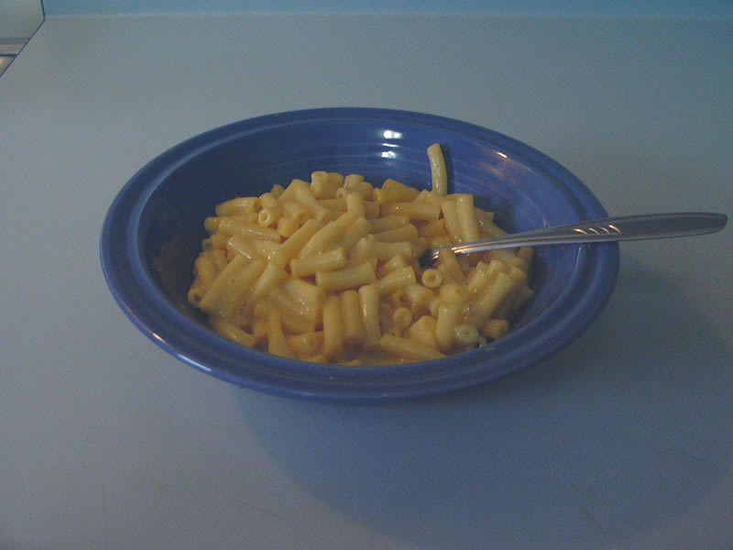
Put the macaroni in a bowl, and it’s ready to eat.

Slide 20
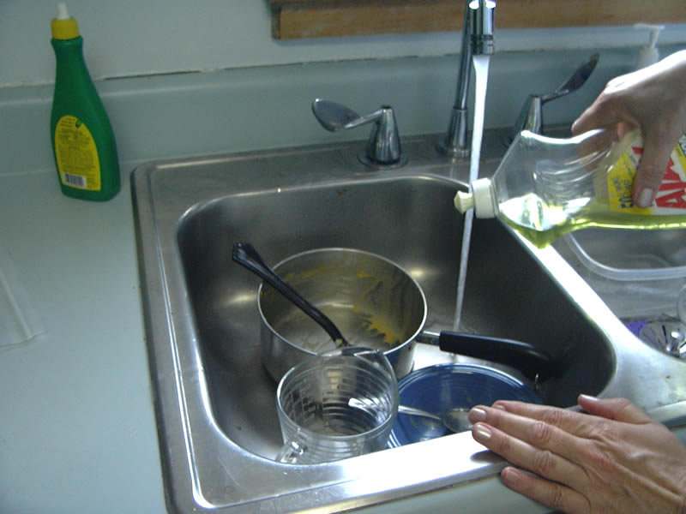
After you eat, it’s time to clean up.

Slide 21
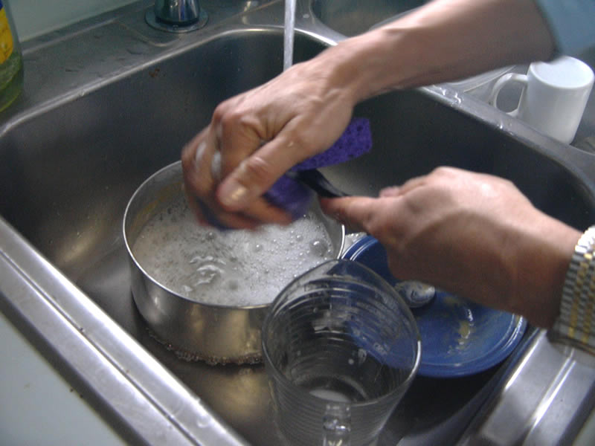
Be sure to wash all your dishes!

Slide 22
The End
This power point book was made by Holly Cooper, Ph.D.; Texas School for the Blind and Visually Impaired Outreach

Slide 23
This power point book was made by Holly Cooper, Ph.D.; Texas School for the Blind and Visually Impaired Outreach

