Slide 1
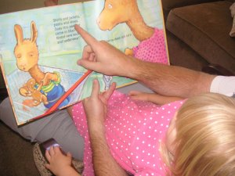
“I’ll Tell You a Story”
Reading Project to Encourage Early Communication
Marcela Viviana Toscano, M.S.

Slide 2
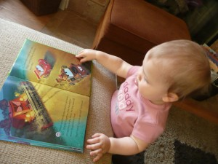
The family is the first place of inclusion for all human beings, the school promotes equality, respect and participation of different ways of being, promoting the construction of the first interactions, contemplating the "ecological niche" (Bronfenbrenner, 1987) in which it is immersed in each family, thus promoting human dignity.

Slide 3
Pediatric Society of Argentina Tryptych:

Slide 5
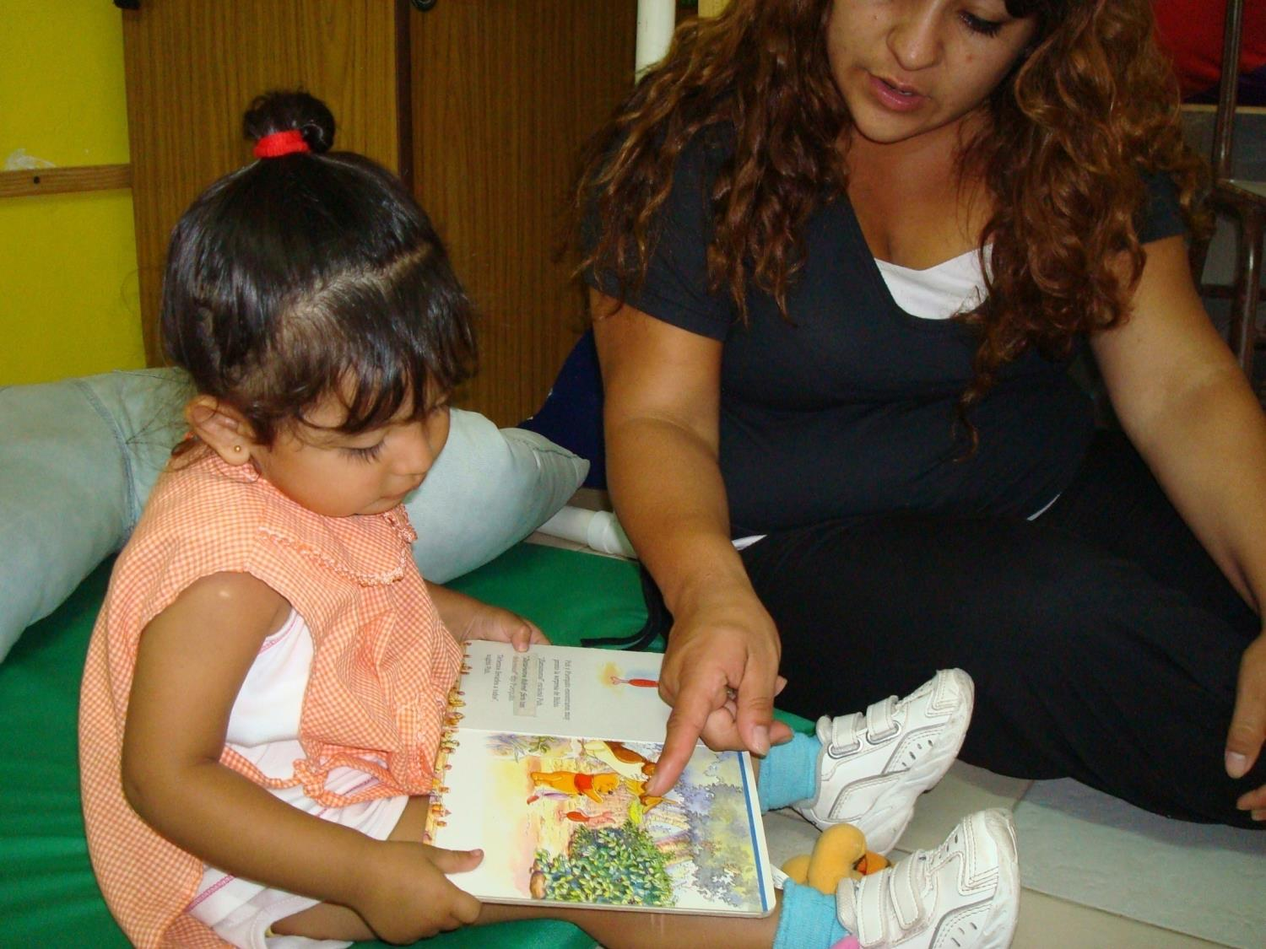
Culture of dialogue…

Slide 6
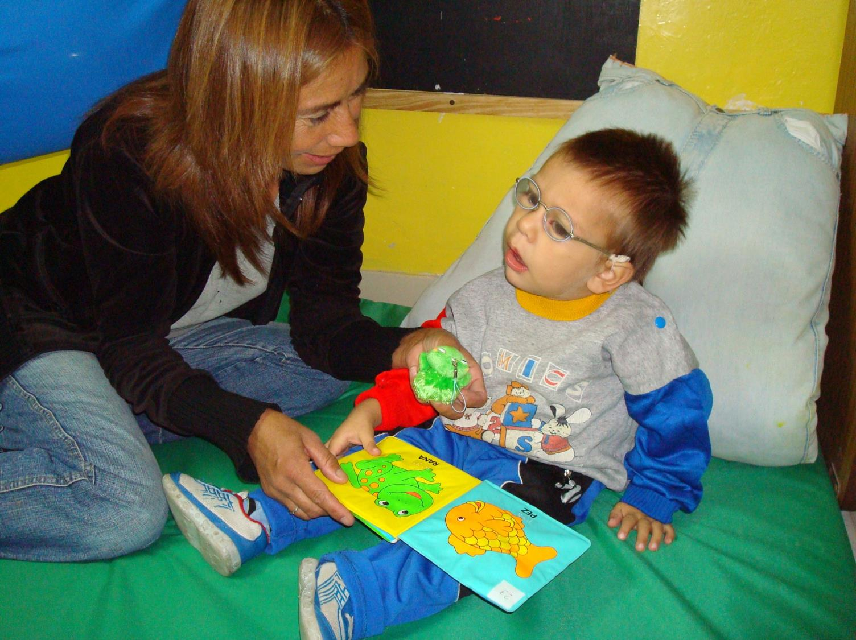
Development of early communication through different types of verbal and non-verbal language

Slide 7
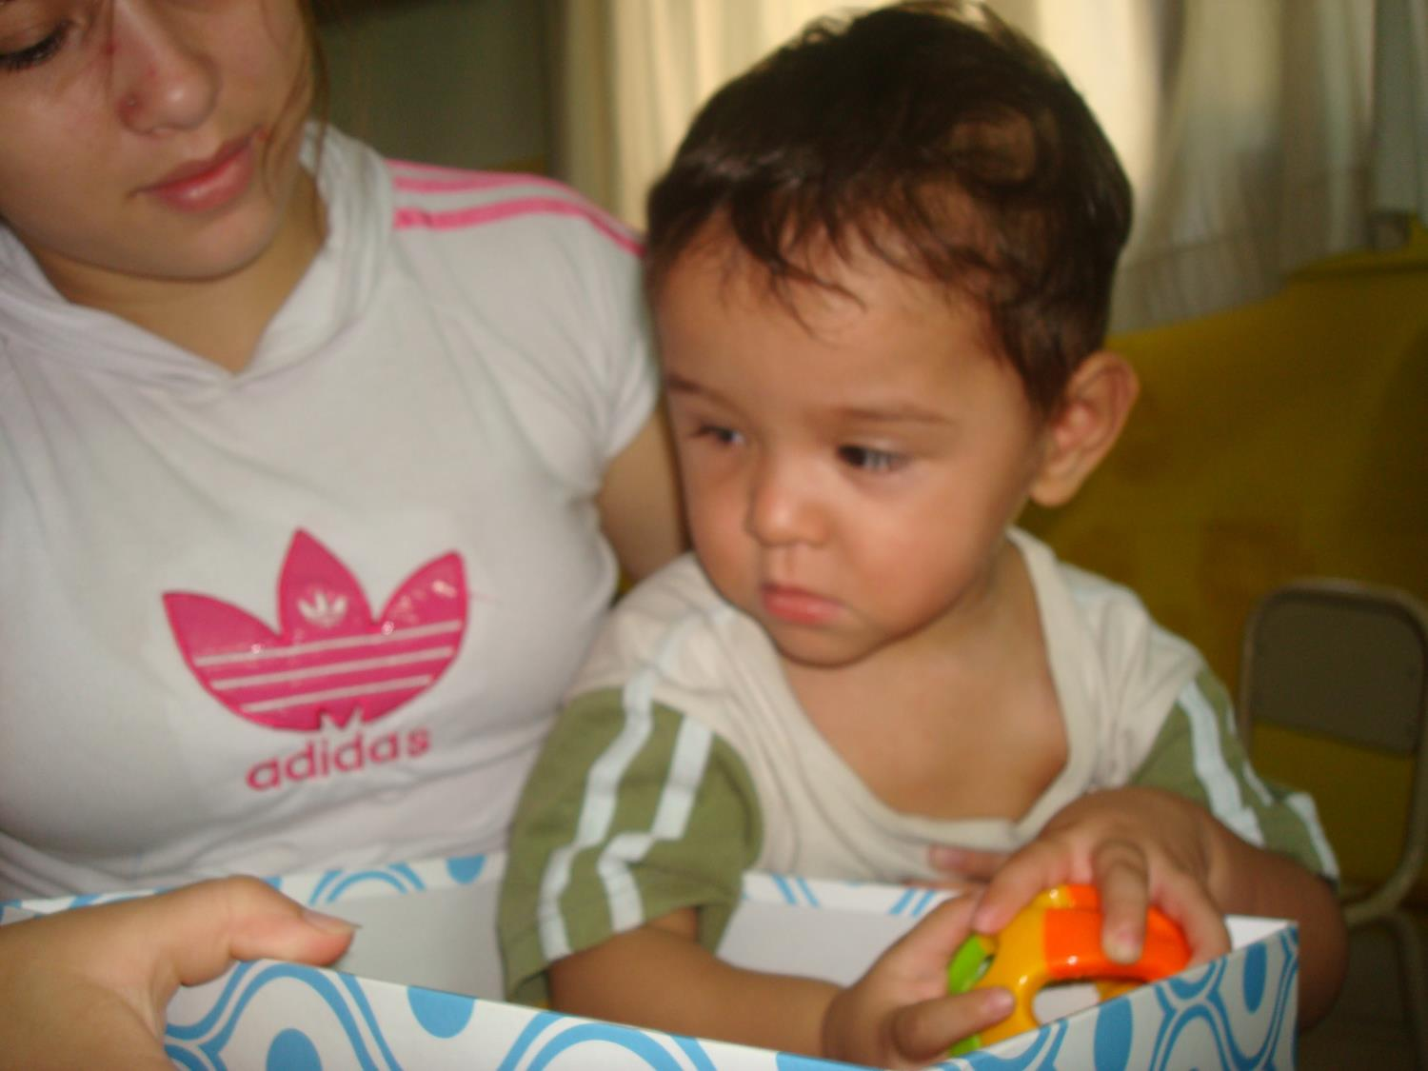
Play at home

Slide 8
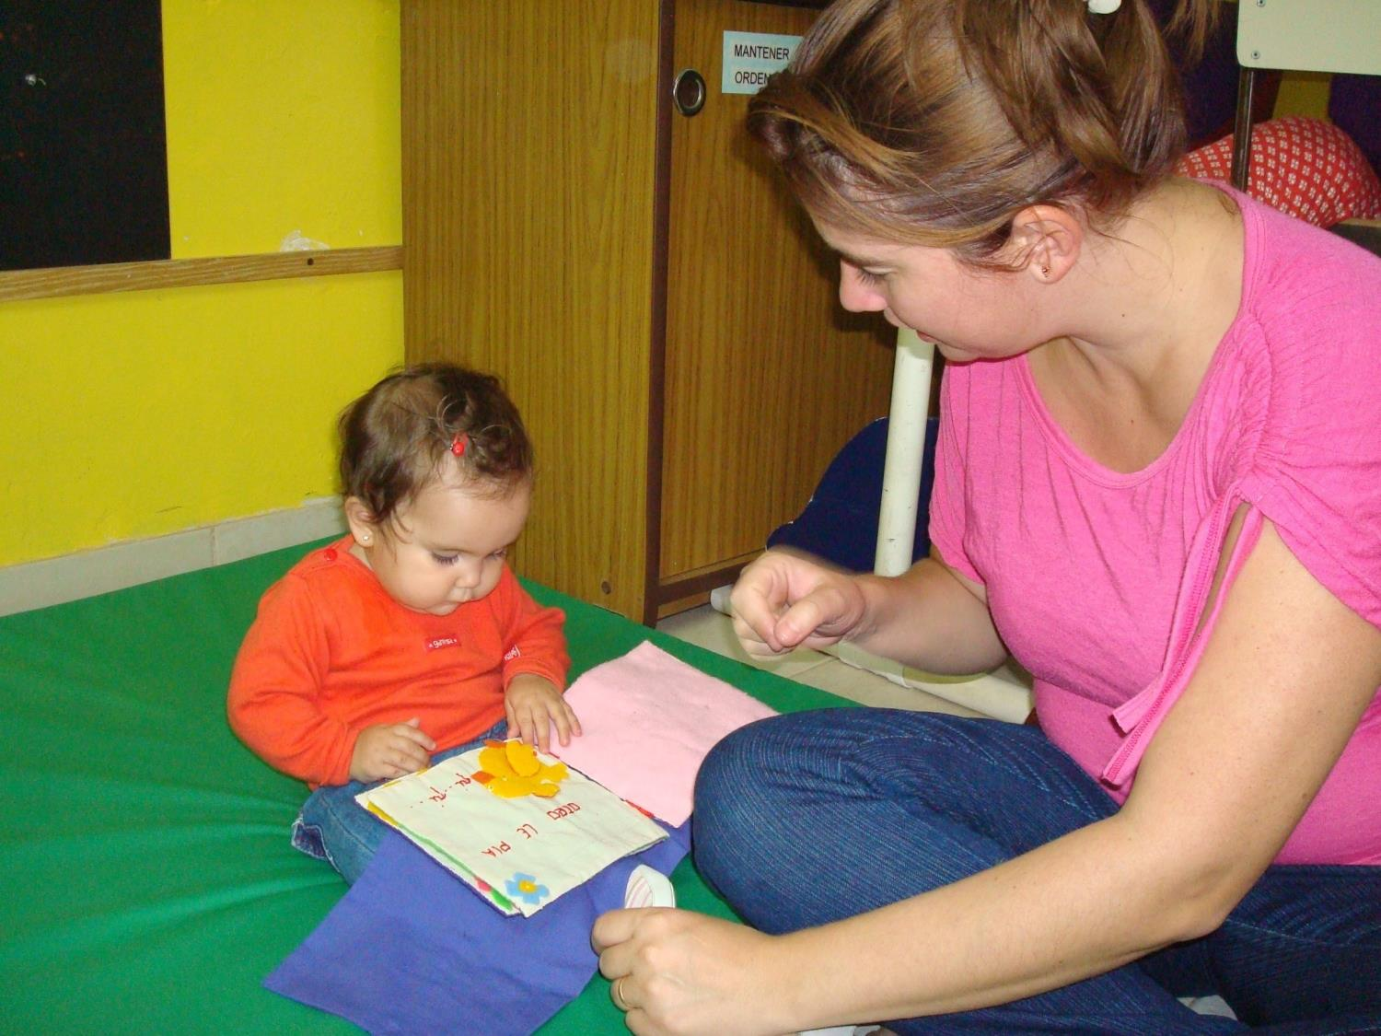

Slide 9
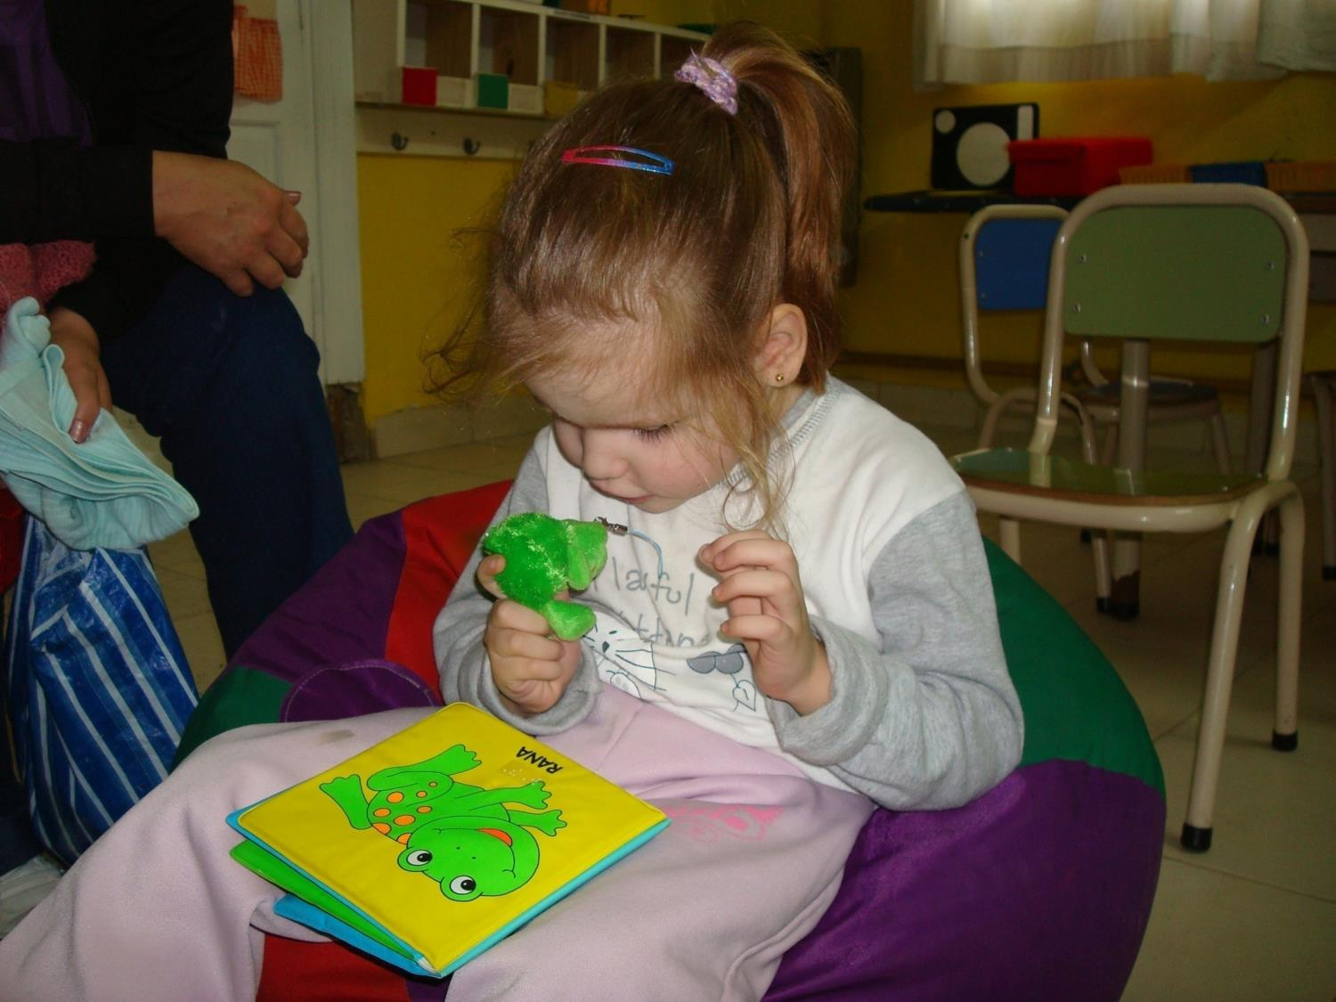
Total communication…

Slide 10
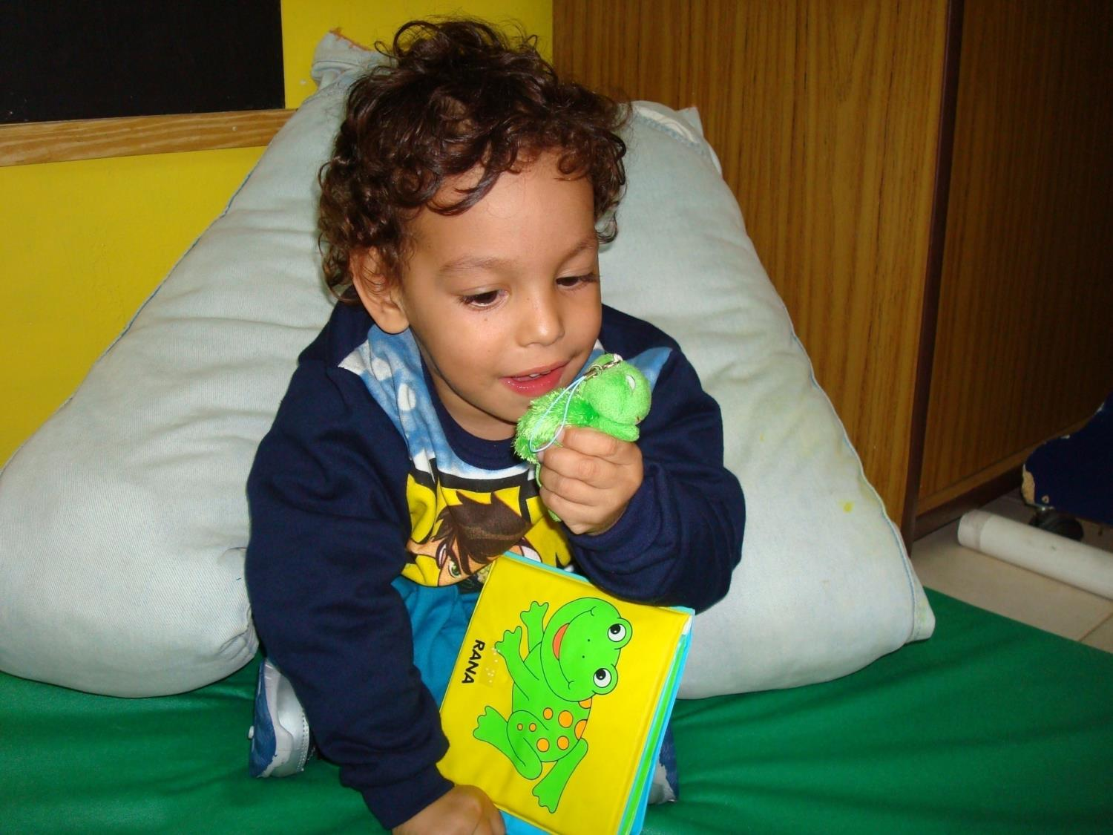

Slide 11
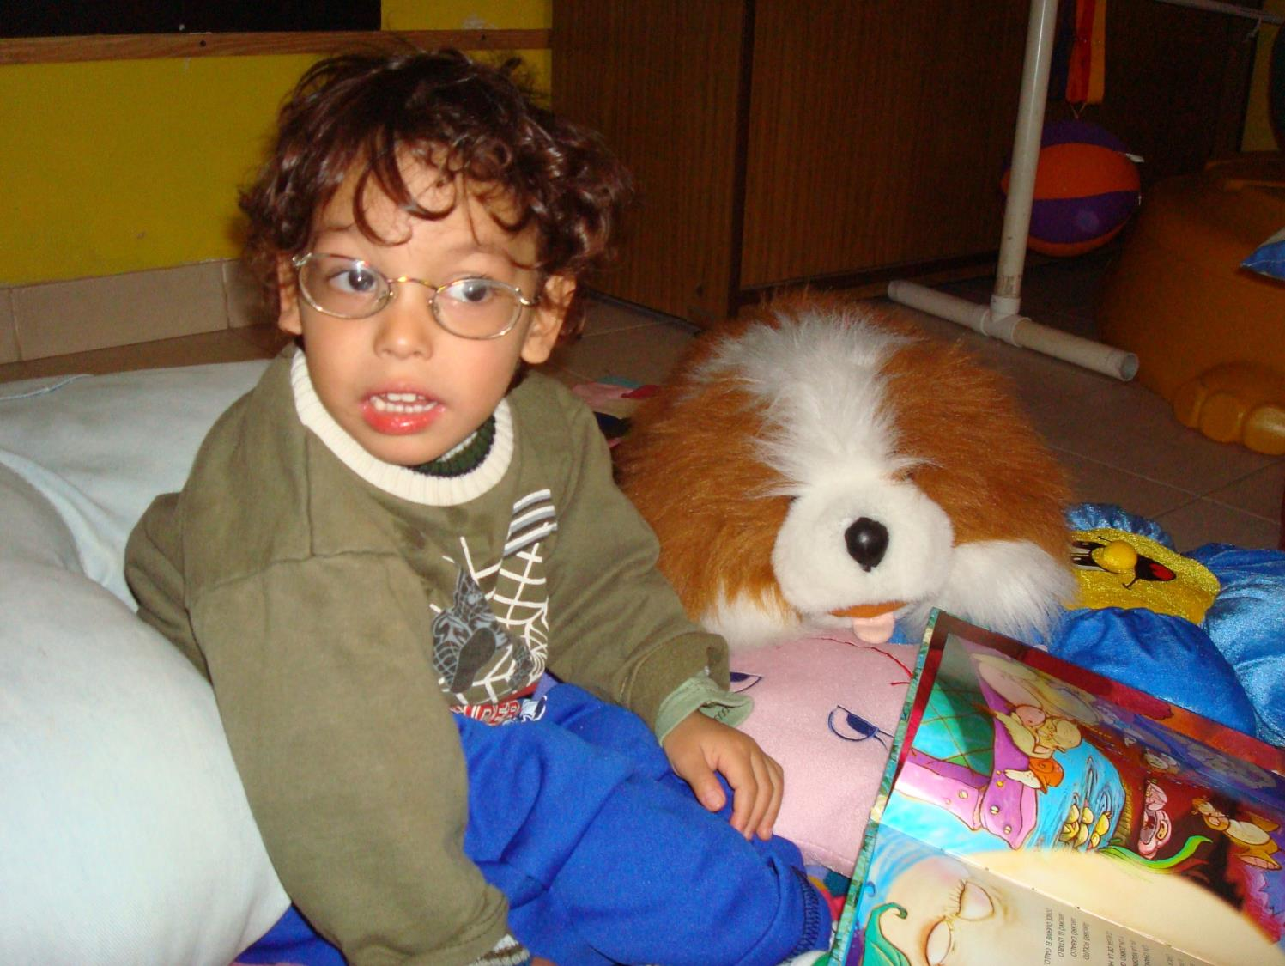

Slide 12
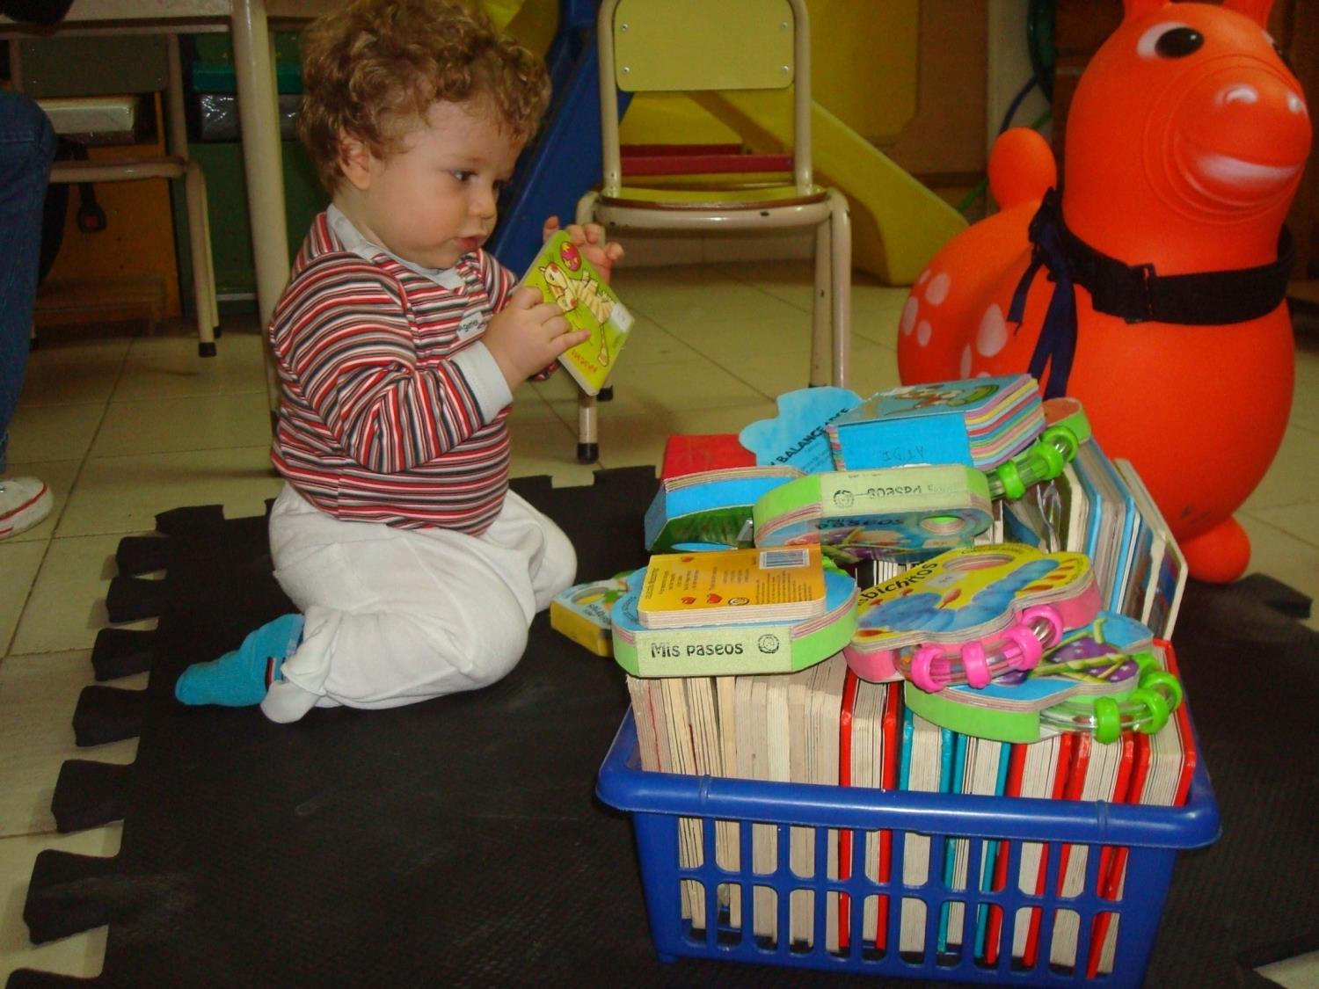
Choices…

Slide 13
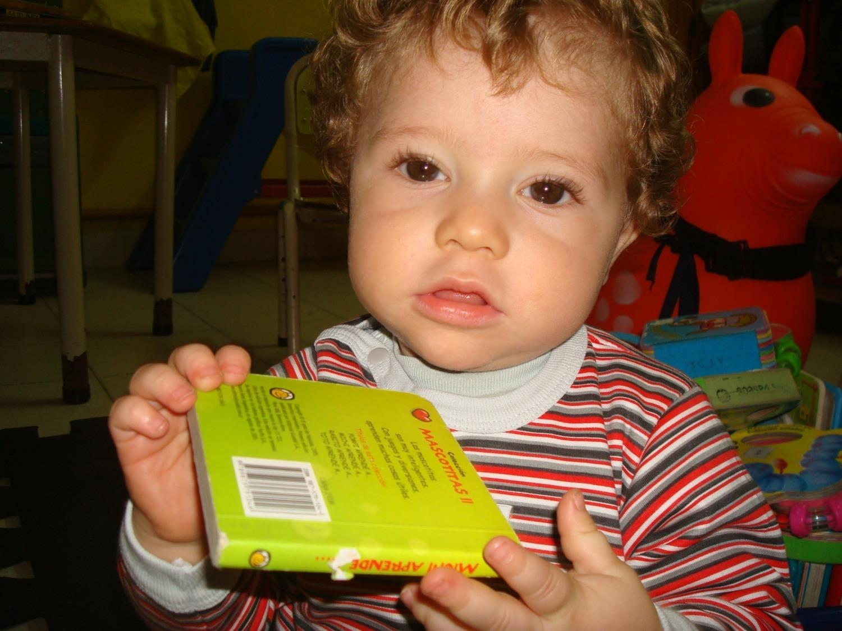

Slide 14
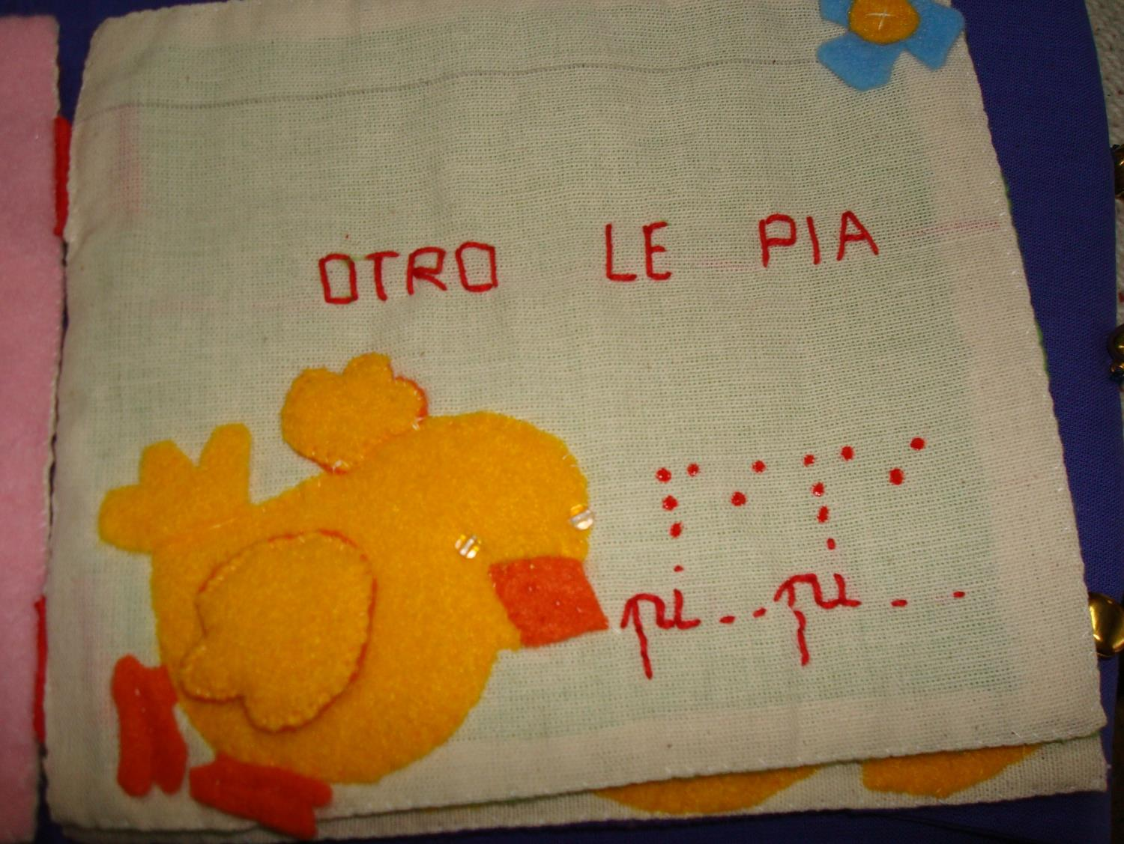
Supports…

Slide 15
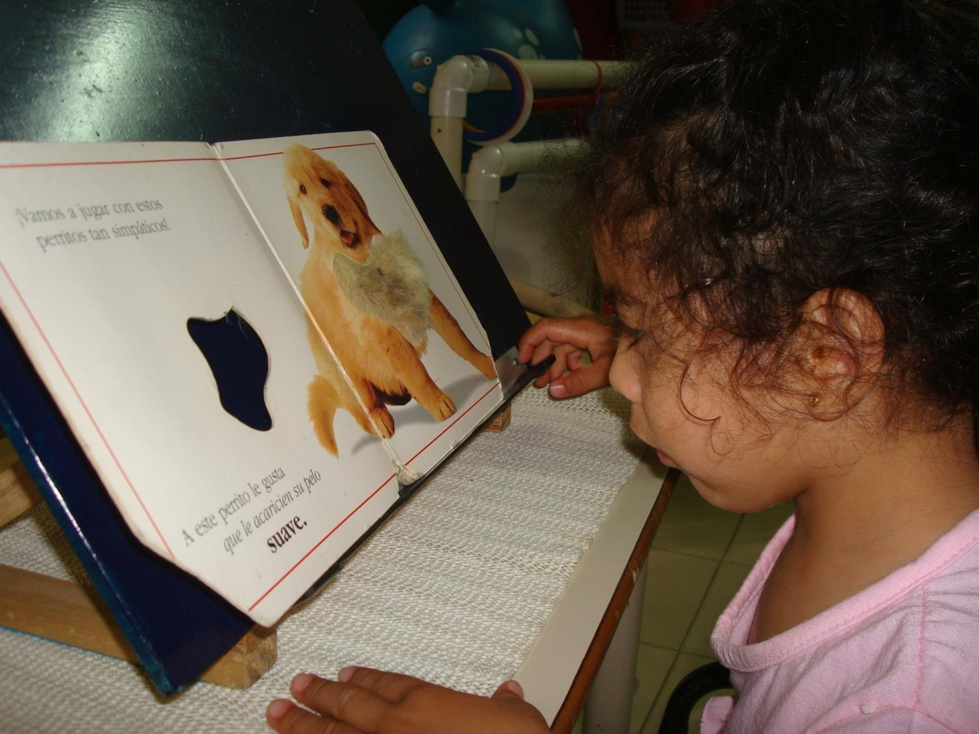

Slide 16
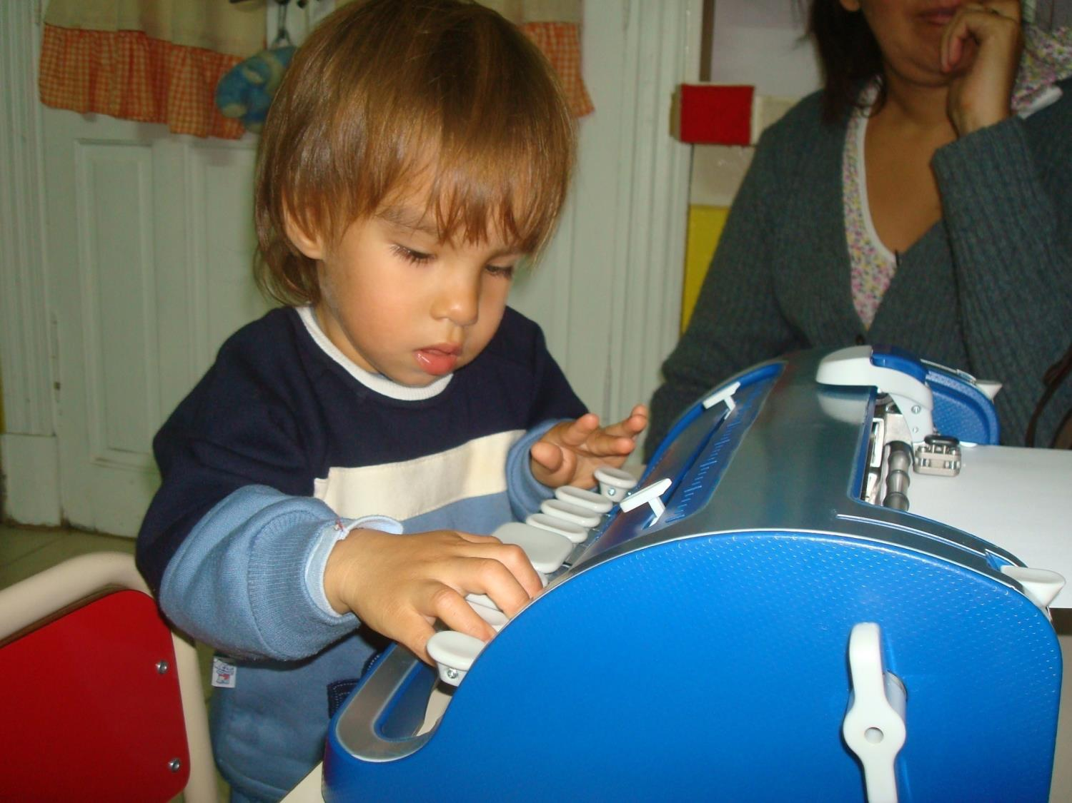

Slide 17
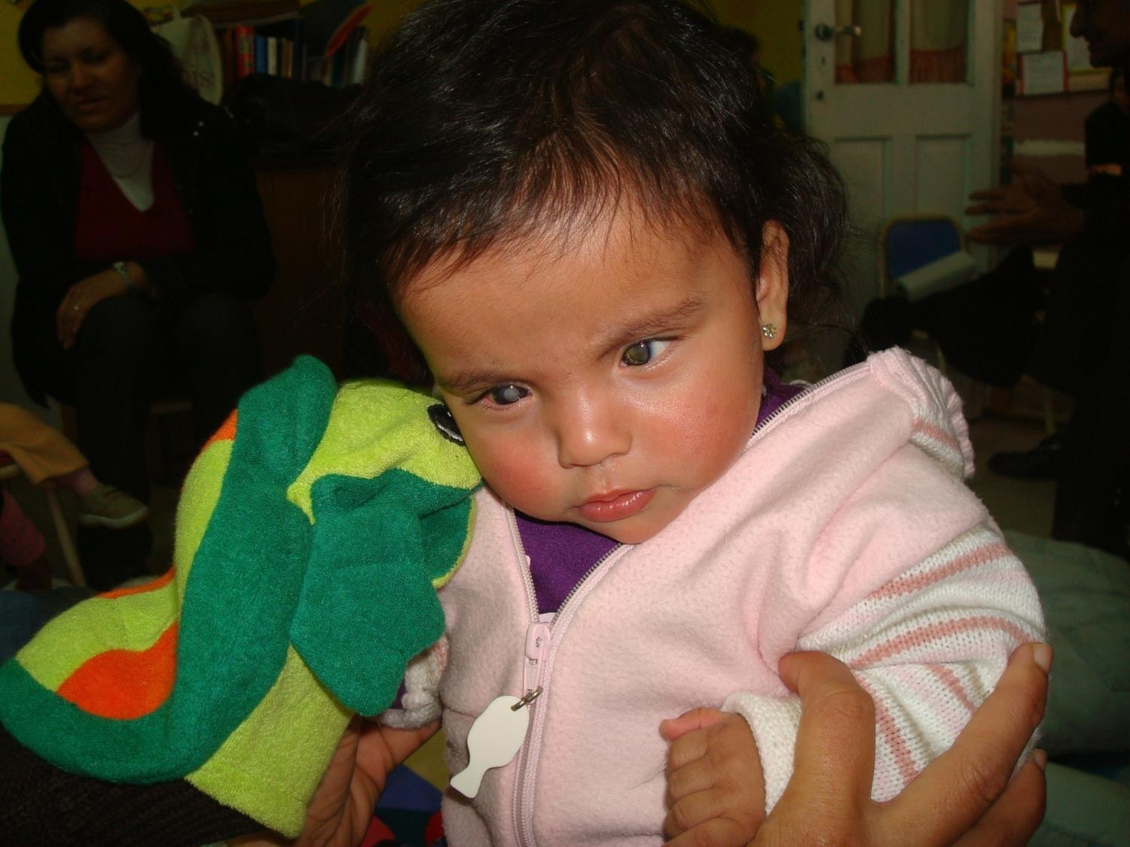

Slide 18
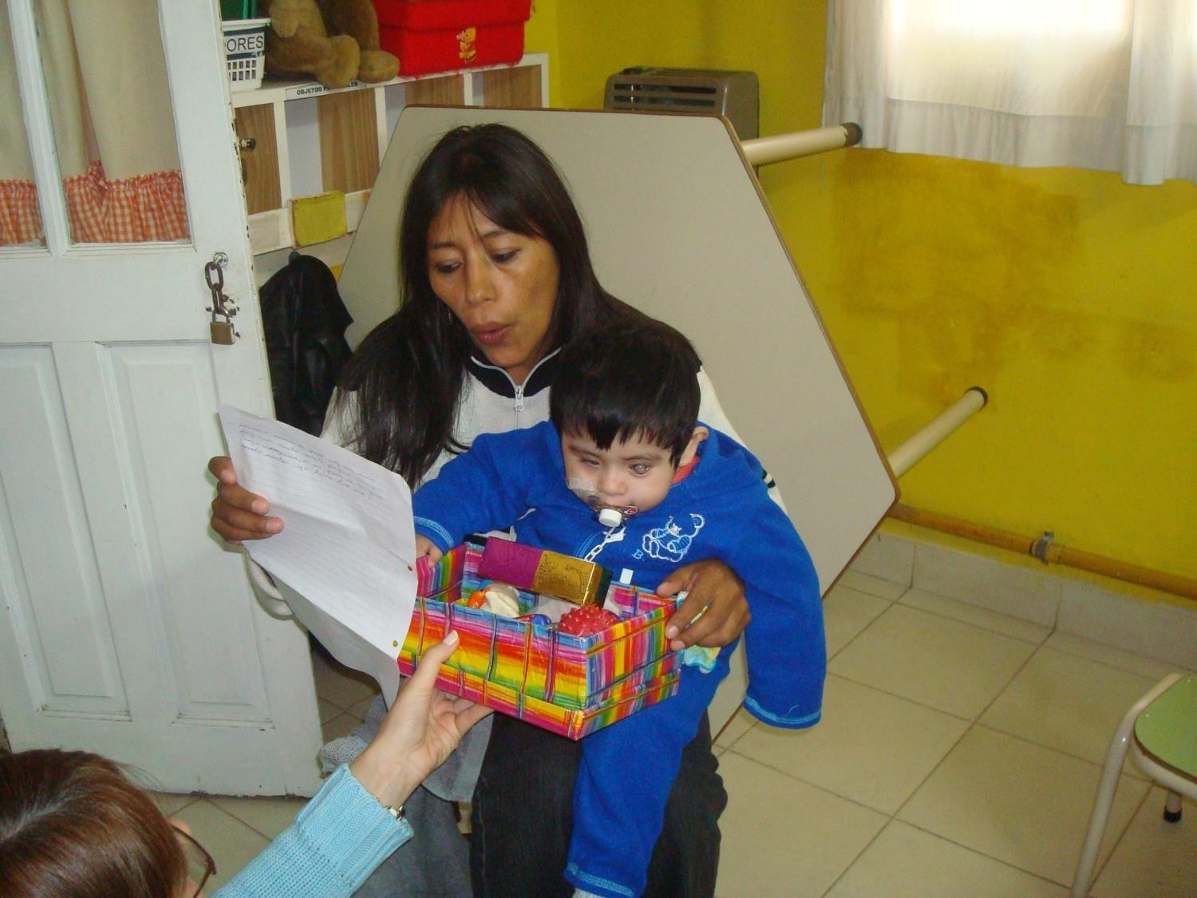
Reading workshop…

Slide 19
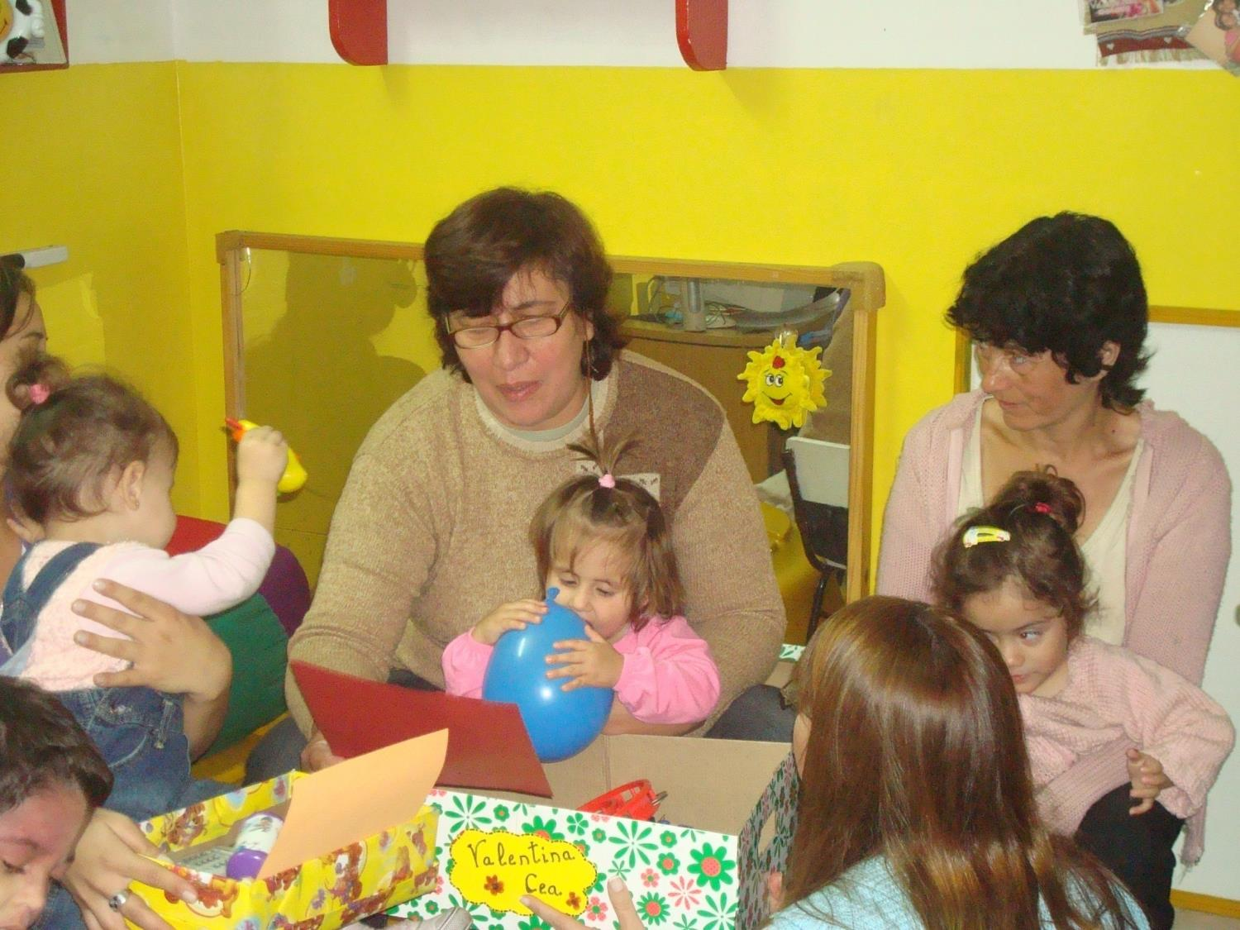

Slide 20
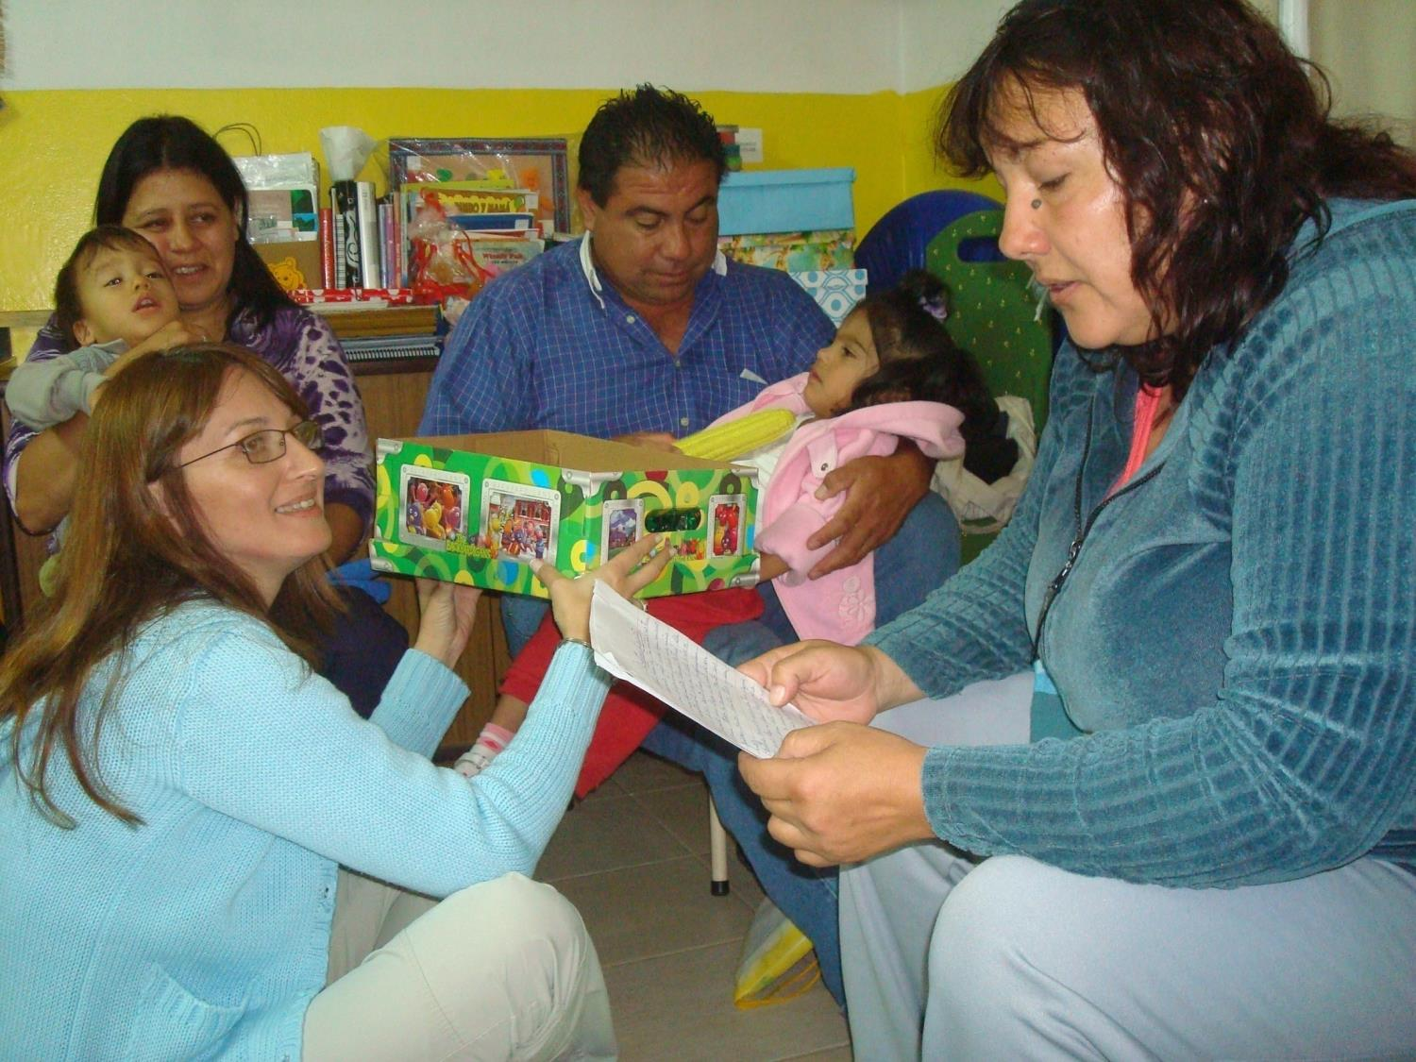

Slide 21
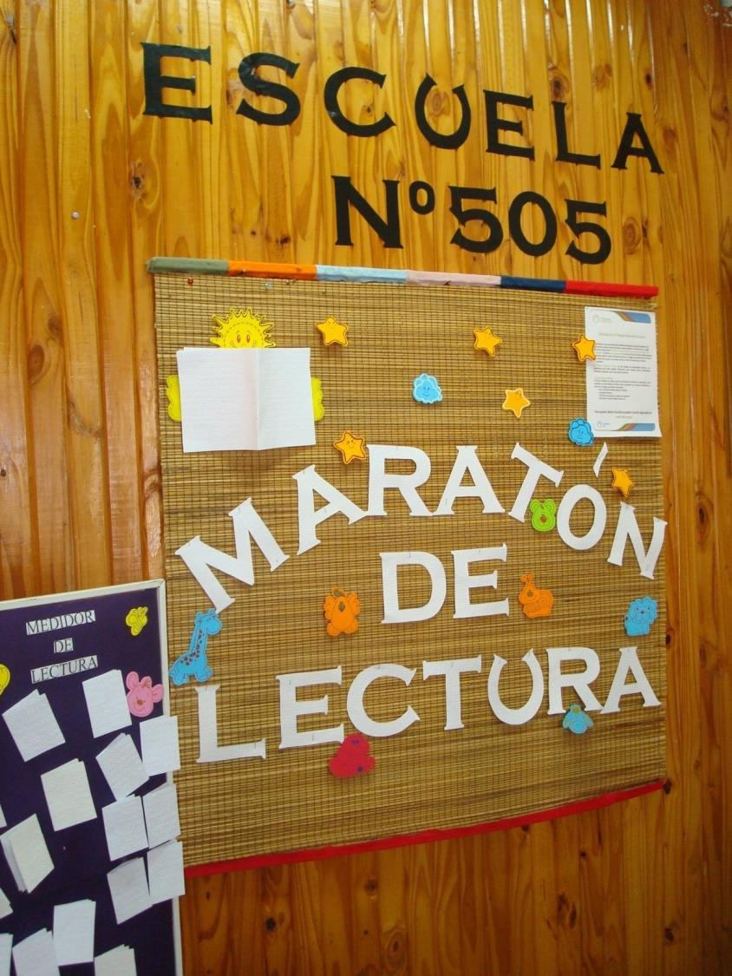

Slide 22
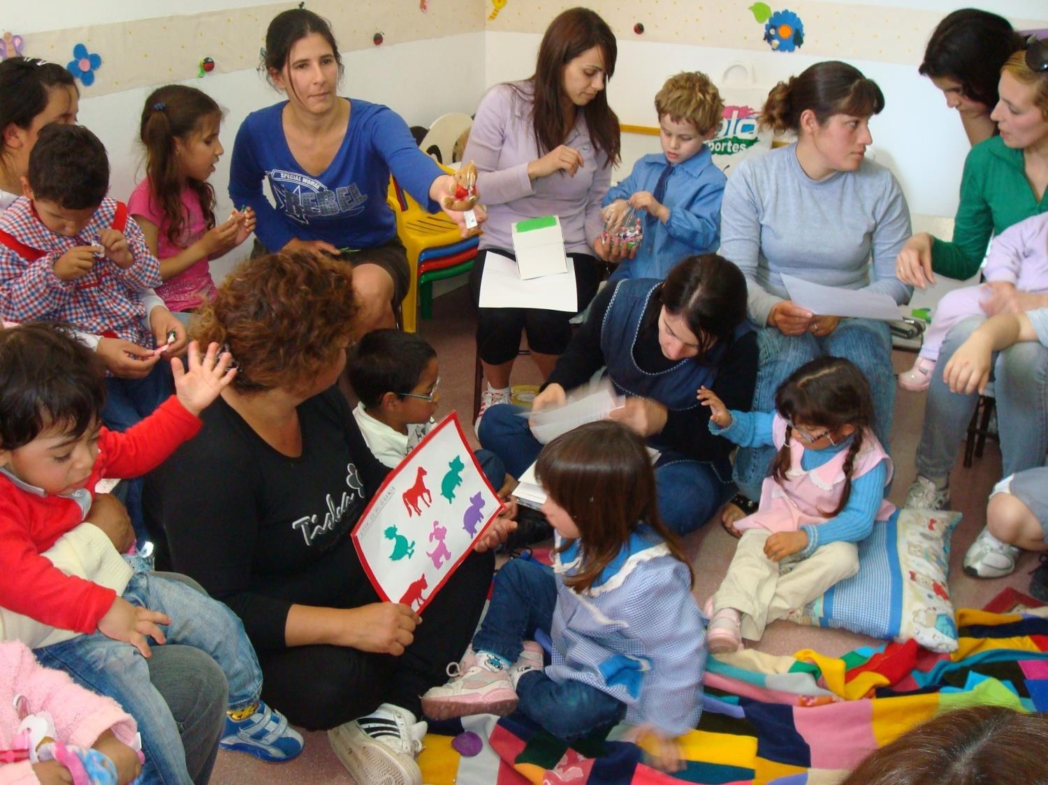

Slide 23
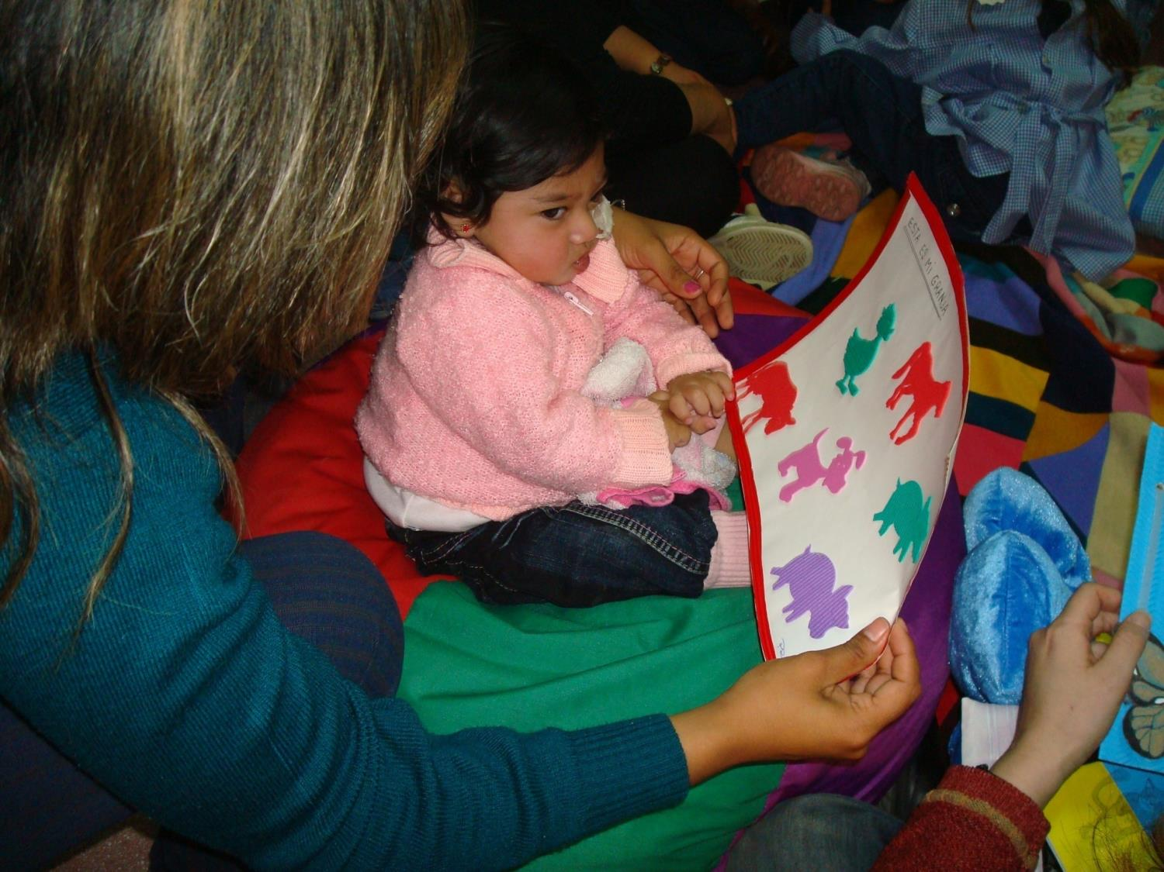

Slide 24
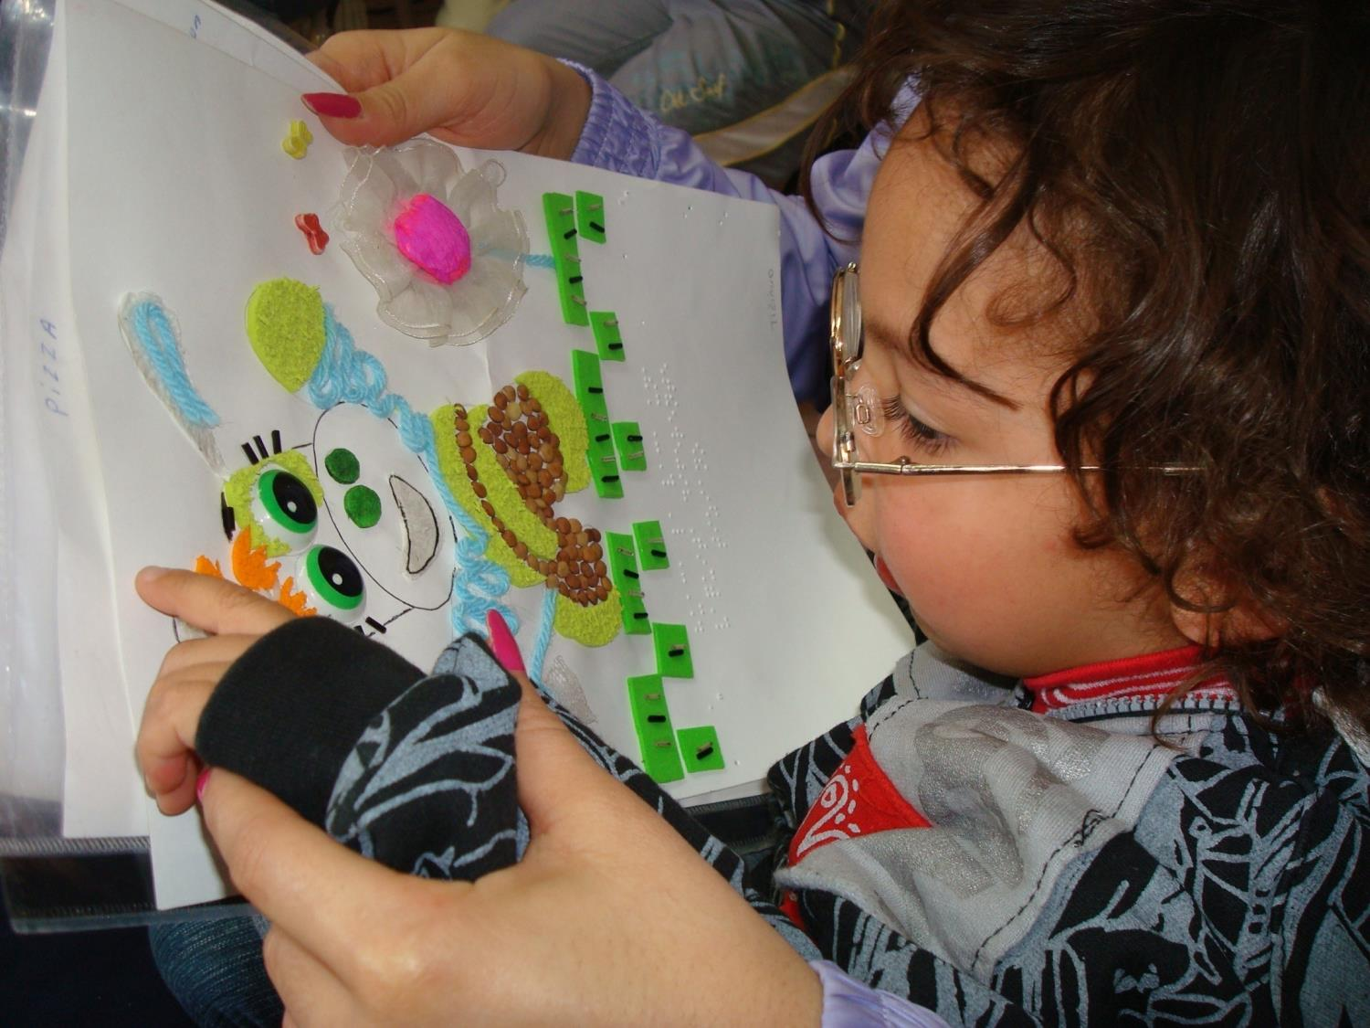

Slide 25
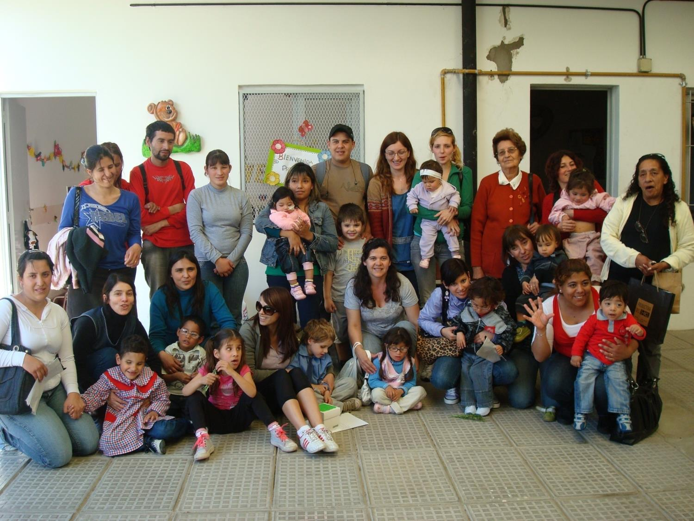

Slide 26
The families tell us:

Slide 30
The home…

Slide 31
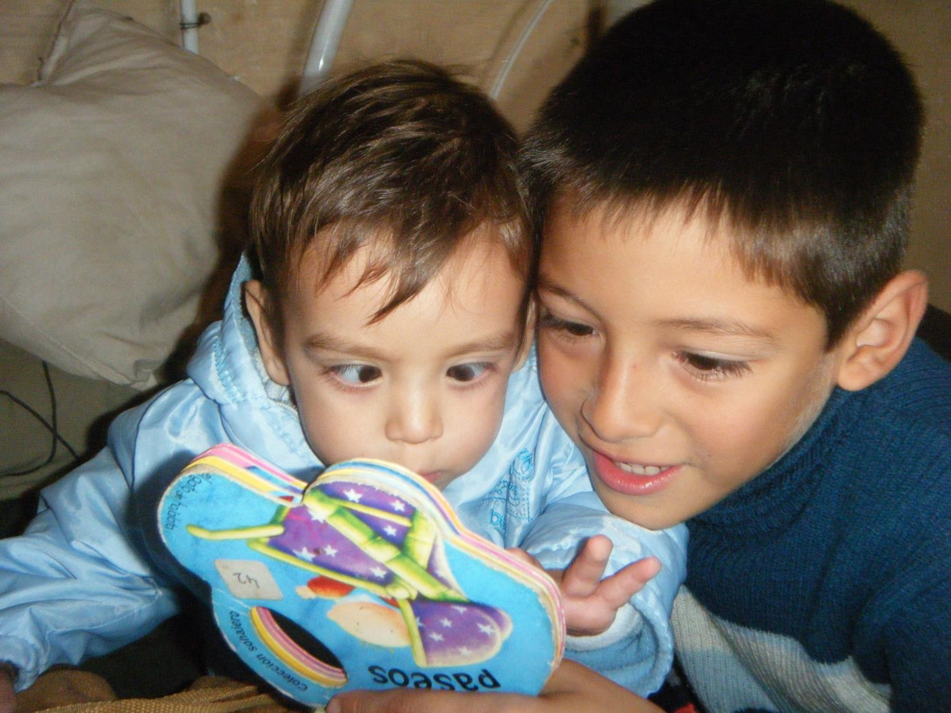

Slide 32
